Slide 1
Lecture No. 12 Corrosion Science
At the end of this lecture, student will be able to:
Describe the following corrosion control methods:
Protective oxide layer
Galvanizing
Tinning
Cathodic protection - Sacrificial anode and Impressed current method
Painting
Inhibitors

Slide 2
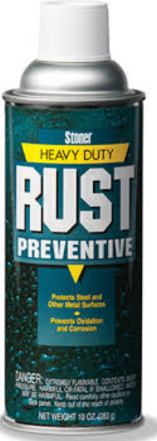

Protective coating
(iii) Organic Coatings:
Paints, enamel, varnishes and lacquers applied on clean metal surface act as inert barriers
Coatings not only protect the metal but also offer decorative appeal
Paints are mixture of pigments, drying oil,
Synthetic resin, thinners and driers
Enamels are pigmented varnishes gives
hard and glossy finish
Notes:
Varnishes is resin dissolved in a liquid for applying on wood, metal, or other materials to form a hard, clear, shiny surface when dry
Lacquer is a liquid made of shellac dissolved in alcohol, or of synthetic substances, that dries to form a hard protective coating for wood, metal, etc.

Slide 3
Metal Coatings
Anodic metal coating (b) Cathodic metal coating
Anodic metal coating:
Coatings which are anodic to the base metal
Example: Coatings of Aluminum, magnesium and zinc over iron
Characteristic feature is that the base metal will not corrode even if the metal coating peals off due to large anodic area and small cathodic areas

Slide 4
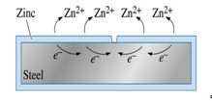
Anodic metal coating
Galvanization is the process of applying a protective zinc coating to steel or iron, to prevent rusting
The most common method is hot-dip galvanization, in which parts are submerged in a bath of molten zinc
Galvanizing protects in two ways:
Forms a coating of corrosion-resistant zinc which prevents corrosive substances from reaching the more delicate metal
Zinc serves as a sacrificial anode so that even if the coating is scratched, the exposed steel will still be protected by the remaining zinc.

Slide 5
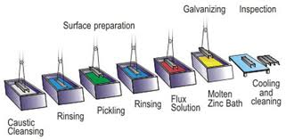
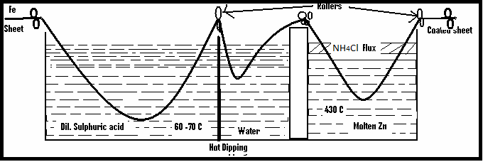
Galvanizing
Hot dipping (Galvanizing): process of
coatings Zinc over iron by hot dipping
Process(Galvanizing):

Slide 6
Galvanizing
Galvanizing is widely used for protecting iron exposed to the atmosphere, as is the case with roofs, wire fences, pipes and articles fabricated from galvanized sheets like buckets, tubes, etc.,
Galvanized ware is not used for keeping eatables because of the solubility of zinc
Popularity of galvanizing is due the low cost of zinc
Easy application and the anodic protection offered by the zinc.

Slide 7
Cathodic Metal Coating
Metal coats which are cathodic in nature to the base metal are called cathodic metal coats
Examples are coating of tin, nickel, chromium and copper on iron
Coating is carefully done without any pinholes to avoid large cathodic area and small anodic area

Slide 8
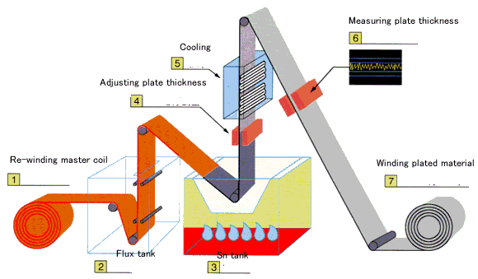
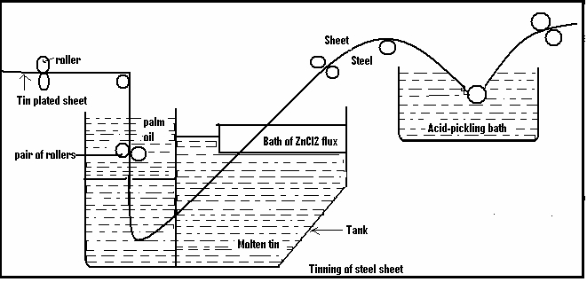
Tinning
Process of coating tin over the iron or steel articles to protect it from corrosion is known as tinning
Tin is a nobler metal than iron, therefore, it has more resistance to chemical attack

Slide 9
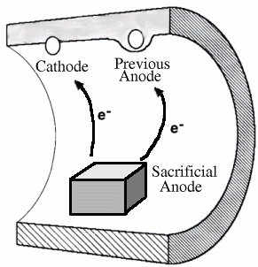
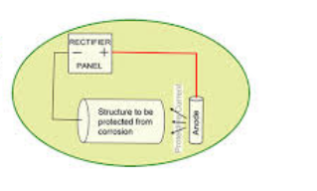
Cathodic protection
Technique of offering protection to a specimen against corrosion by providing electrons from external source
Principle involved in cathodic protection is to force the metal to behave like a cathode
Since there will not be any anodic area on the metal, corrosion does not occur
There are two types:
Sacrificial anode method
Impressed voltage method

Slide 10
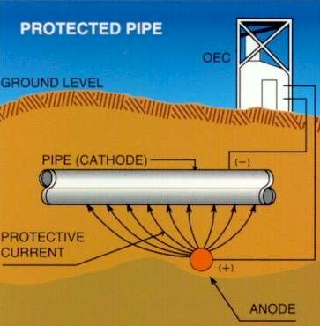
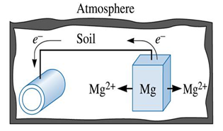
Sacrificial Anode Method
Involves the use of a metal, which is anodic to the specimen
Example: Base metals such as Iron, Copper and alloys like brass can be protected by sacrificial anode method
Sacrificial anode is used to protect buried pipelines, ship hulls, industrial water tanks and steel rods

Slide 11
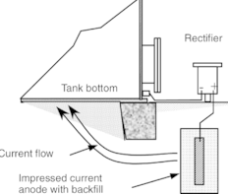
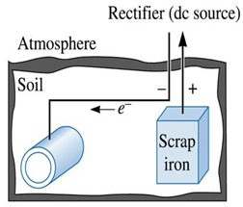
Impressed voltage method:
Current is applied in the opposite direction to nullify the corrosion current and converting the corroding metal from anode to cathode
Structure to be protected is connected to the negative terminal of DC power supply
Application: water coolers, water tanks, buried oil and water pipes, transmission towers, sulphuric acid storage tanks, etc.

Slide 12

Corrosion inhibitor
Chemicals which are added in small quantities to the corroding medium in order to reduce the corrosion rate are called corrosion inhibitors
Reduce corrosion by forming a protective film either at the cathode or anode
Types of corrosion inhibitors
Anodic inhibitor ii. Cathodic inhibitor

Slide 13
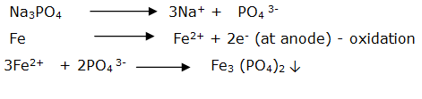
Anodic inhibitors
This is achieved by addition of anions such as chromate, tungstate, molybdate, phosphate etc
These anions combine with metal ions formed at the anodes forming sparingly soluble respective salts
These salts get deposited on the anodic side and acts as a barrier between the metal surface and the corrosive environment
Anodic inhibitors are found to be effective only when sufficient quantities of inhibitors are added

Slide 14

Corrosion inhibitors
ii. Cathodic inhibitor:
Prevents the cathodic reaction that takes place during corrosion
Organic compounds such as mercaptans, amines and sulphoxides are used during the presence of acidic media
Prevent the evolution of hydrogen in the cathodic region so that the rate of corrosion decreases
Sulphates of Zn, Mg, Mn and Ni are used in presence of neutral or alkaline medium
React with hydroxyl ion liberated at cathode and forms insoluble hydroxide to form a protective film that prevents corrosion
Rate of cathodic reaction can be reduced by adding deaerator such as
Hydrazine, sodium sulphate

Slide 15
Summary
Corrosion control methods:
Protective oxide layer: organic coats -paints
Galvanizing – coating of zinc on iron
Tinning – coating of tin on iron
Cathodic protection:
Sacrificial anode – Attachment of Zn or Mg to base metal
Impressed current- application of current to protect base metal
Inhibitors: Cathodic and anodic – reduces the rate of corrosion

